Slide 1
Huge Integer Division

Slide 2
if( dividend == 0 )
quotient = 0
remainder = 0
else if( dividend < divisor )
quotient = 0
remainder = dividend
else if( dividend == divisor )
quotient = 1
remainder = 0

Slide 3
else
n = dividendSize – divisorSize
buffer = divisor shift left by n positions
if( dividend < buffer )
quotientSize = dividendSize – divisorSize
else
quotientSize = dividendSize – divisorSize + 1
quotient = 0
for( k = quotientSize - 1; k >= 0; k-- )
quotient[k] = 10;
do {
quotient[k]--
buffer = divisor * quotient
} while( dividend < buffer )
if( dividend == buffer )
break
remainder = dividend - buffer

Slide 4
n = dividendSize – divisorSize
buffer = divisor shift left by n positions
if( dividend < buffer )
quotientSize = dividendSize – divisorSize
else
quotientSize = dividendSize – divisorSize + 1
quotient = 0
 | 9 | 8 | 7 | 6 | 5 | 4 | 3 | 2 | 1 | 0
dividend | 0 | 0 | 0 | 9 | 8 | 7 | 6 | 5 | 4 | 3
dividendSize | 7
 | 9 | 8 | 7 | 6 | 5 | 4 | 3 | 2 | 1 | 0
divisor | 0 | 0 | 0 | 0 | 0 | 0 | 1 | 1 | 1 | 1
divisorSize | 4
 | 9 | 8 | 7 | 6 | 5 | 4 | 3 | 2 | 1 | 0
quotient
quotientSize
 | 9 | 8 | 7 | 6 | 5 | 4 | 3 | 2 | 1 | 0
buffer
k

Slide 5
n = dividendSize – divisorSize
buffer = divisor shift left by n positions
if( dividend < buffer )
quotientSize = dividendSize – divisorSize
else
quotientSize = dividendSize – divisorSize + 1
quotient = 0
 | 9 | 8 | 7 | 6 | 5 | 4 | 3 | 2 | 1 | 0
dividend | 0 | 0 | 0 | 9 | 8 | 7 | 6 | 5 | 4 | 3
dividendSize | 7
 | 9 | 8 | 7 | 6 | 5 | 4 | 3 | 2 | 1 | 0
divisor | 0 | 0 | 0 | 0 | 0 | 0 | 1 | 1 | 1 | 1
divisorSize | 4
 | 9 | 8 | 7 | 6 | 5 | 4 | 3 | 2 | 1 | 0
quotient
quotientSize
 | 9 | 8 | 7 | 6 | 5 | 4 | 3 | 2 | 1 | 0
buffer | 0 | 0 | 0 | 1 | 1 | 1 | 1 | 0 | 0 | 0
k

Slide 6
n = dividendSize – divisorSize
buffer = divisor shift left by n positions
if( dividend < buffer )
quotientSize = dividendSize – divisorSize
else
quotientSize = dividendSize – divisorSize + 1
quotient = 0
 | 9 | 8 | 7 | 6 | 5 | 4 | 3 | 2 | 1 | 0
dividend | 0 | 0 | 0 | 9 | 8 | 7 | 6 | 5 | 4 | 3
dividendSize | 7
 | 9 | 8 | 7 | 6 | 5 | 4 | 3 | 2 | 1 | 0
divisor | 0 | 0 | 0 | 0 | 0 | 0 | 1 | 1 | 1 | 1
divisorSize | 4
 | 9 | 8 | 7 | 6 | 5 | 4 | 3 | 2 | 1 | 0
quotient
quotientSize | 3
 | 9 | 8 | 7 | 6 | 5 | 4 | 3 | 2 | 1 | 0
buffer | 0 | 0 | 0 | 1 | 1 | 1 | 1 | 0 | 0 | 0
k

Slide 7
n = dividendSize – divisorSize
buffer = divisor shift left by n positions
if( dividend < buffer )
quotientSize = dividendSize – divisorSize
else
quotientSize = dividendSize – divisorSize + 1
quotient = 0
 | 9 | 8 | 7 | 6 | 5 | 4 | 3 | 2 | 1 | 0
dividend | 0 | 0 | 0 | 9 | 8 | 7 | 6 | 5 | 4 | 3
dividendSize | 7
 | 9 | 8 | 7 | 6 | 5 | 4 | 3 | 2 | 1 | 0
divisor | 0 | 0 | 0 | 0 | 0 | 0 | 1 | 1 | 1 | 1
divisorSize | 4
 | 9 | 8 | 7 | 6 | 5 | 4 | 3 | 2 | 1 | 0
quotient
quotientSize | 4
 | 9 | 8 | 7 | 6 | 5 | 4 | 3 | 2 | 1 | 0
buffer | 0 | 0 | 0 | 1 | 1 | 1 | 1 | 0 | 0 | 0
k

Slide 8
n = dividendSize – divisorSize
buffer = divisor shift left by n positions
if( dividend < buffer )
quotientSize = dividendSize – divisorSize
else
quotientSize = dividendSize – divisorSize + 1
quotient = 0
 | 9 | 8 | 7 | 6 | 5 | 4 | 3 | 2 | 1 | 0
dividend | 0 | 0 | 0 | 9 | 8 | 7 | 6 | 5 | 4 | 3
dividendSize | 7
 | 9 | 8 | 7 | 6 | 5 | 4 | 3 | 2 | 1 | 0
divisor | 0 | 0 | 0 | 0 | 0 | 0 | 1 | 1 | 1 | 1
divisorSize | 4
 | 9 | 8 | 7 | 6 | 5 | 4 | 3 | 2 | 1 | 0
quotient | 0 | 0 | 0 | 0 | 0 | 0 | 0 | 0 | 0 | 0
quotientSize | 4
 | 9 | 8 | 7 | 6 | 5 | 4 | 3 | 2 | 1 | 0
buffer | 0 | 0 | 0 | 1 | 1 | 1 | 1 | 0 | 0 | 0
k

Slide 9
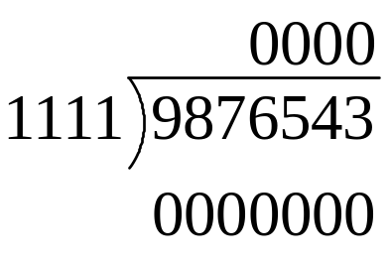
for( k = quotientSize - 1; k >= 0; k-- )
quotient[k] = 10;
do {
quotient[k]--
buffer = divisor * quotient
} while( dividend < buffer )
if( dividend == buffer )
break
 | 9 | 8 | 7 | 6 | 5 | 4 | 3 | 2 | 1 | 0
dividend | 0 | 0 | 0 | 9 | 8 | 7 | 6 | 5 | 4 | 3
dividendSize | 7
 | 9 | 8 | 7 | 6 | 5 | 4 | 3 | 2 | 1 | 0
divisor | 0 | 0 | 0 | 0 | 0 | 0 | 1 | 1 | 1 | 1
divisorSize | 4
 | 9 | 8 | 7 | 6 | 5 | 4 | 3 | 2 | 1 | 0
quotient | 0 | 0 | 0 | 0 | 0 | 0 | 0 | 0 | 0 | 0
quotientSize | 4
 | 9 | 8 | 7 | 6 | 5 | 4 | 3 | 2 | 1 | 0
buffer
k | 3

Slide 10
for( k = quotientSize - 1; k >= 0; k-- )
quotient[k] = 10;
do {
quotient[k]--
buffer = divisor * quotient
} while( dividend < buffer )
if( dividend == buffer )
break
 | 9 | 8 | 7 | 6 | 5 | 4 | 3 | 2 | 1 | 0
dividend | 0 | 0 | 0 | 9 | 8 | 7 | 6 | 5 | 4 | 3
dividendSize | 7
 | 9 | 8 | 7 | 6 | 5 | 4 | 3 | 2 | 1 | 0
divisor | 0 | 0 | 0 | 0 | 0 | 0 | 1 | 1 | 1 | 1
divisorSize | 4
 | 9 | 8 | 7 | 6 | 5 | 4 | 3 | 2 | 1 | 0
quotient | 0 | 0 | 0 | 0 | 0 | 0 | 10 | 0 | 0 | 0
quotientSize | 4
 | 9 | 8 | 7 | 6 | 5 | 4 | 3 | 2 | 1 | 0
buffer
k | 3

Slide 11

for( k = quotientSize - 1; k >= 0; k-- )
quotient[k] = 10;
do {
quotient[k]--
buffer = divisor * quotient
} while( dividend < buffer )
if( dividend == buffer )
break
 | 9 | 8 | 7 | 6 | 5 | 4 | 3 | 2 | 1 | 0
dividend | 0 | 0 | 0 | 9 | 8 | 7 | 6 | 5 | 4 | 3
dividendSize | 7
 | 9 | 8 | 7 | 6 | 5 | 4 | 3 | 2 | 1 | 0
divisor | 0 | 0 | 0 | 0 | 0 | 0 | 1 | 1 | 1 | 1
divisorSize | 4
 | 9 | 8 | 7 | 6 | 5 | 4 | 3 | 2 | 1 | 0
quotient | 0 | 0 | 0 | 0 | 0 | 0 | 9 | 0 | 0 | 0
quotientSize | 4
 | 9 | 8 | 7 | 6 | 5 | 4 | 3 | 2 | 1 | 0
buffer
k | 3

Slide 12
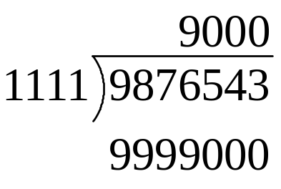
for( k = quotientSize - 1; k >= 0; k-- )
quotient[k] = 10;
do {
quotient[k]--
buffer = divisor * quotient
} while( dividend < buffer )
if( dividend == buffer )
break
 | 9 | 8 | 7 | 6 | 5 | 4 | 3 | 2 | 1 | 0
dividend | 0 | 0 | 0 | 9 | 8 | 7 | 6 | 5 | 4 | 3
dividendSize | 7
 | 9 | 8 | 7 | 6 | 5 | 4 | 3 | 2 | 1 | 0
divisor | 0 | 0 | 0 | 0 | 0 | 0 | 1 | 1 | 1 | 1
divisorSize | 4
 | 9 | 8 | 7 | 6 | 5 | 4 | 3 | 2 | 1 | 0
quotient | 0 | 0 | 0 | 0 | 0 | 0 | 9 | 0 | 0 | 0
quotientSize | 4
 | 9 | 8 | 7 | 6 | 5 | 4 | 3 | 2 | 1 | 0
buffer |  |  |  | 9 | 9 | 9 | 9 | 0 | 0 | 0
k | 3

Slide 13
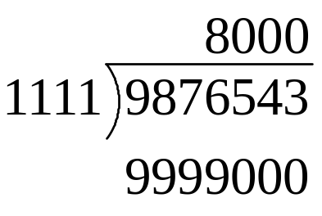
for( k = quotientSize - 1; k >= 0; k-- )
quotient[k] = 10;
do {
quotient[k]--
buffer = divisor * quotient
} while( dividend < buffer )
if( dividend == buffer )
break
 | 9 | 8 | 7 | 6 | 5 | 4 | 3 | 2 | 1 | 0
dividend | 0 | 0 | 0 | 9 | 8 | 7 | 6 | 5 | 4 | 3
dividendSize | 7
 | 9 | 8 | 7 | 6 | 5 | 4 | 3 | 2 | 1 | 0
divisor | 0 | 0 | 0 | 0 | 0 | 0 | 1 | 1 | 1 | 1
divisorSize | 4
 | 9 | 8 | 7 | 6 | 5 | 4 | 3 | 2 | 1 | 0
quotient | 0 | 0 | 0 | 0 | 0 | 0 | 8 | 0 | 0 | 0
quotientSize | 4
 | 9 | 8 | 7 | 6 | 5 | 4 | 3 | 2 | 1 | 0
buffer |  |  |  | 9 | 9 | 9 | 9 | 0 | 0 | 0
k | 3

Slide 14

for( k = quotientSize - 1; k >= 0; k-- )
quotient[k] = 10;
do {
quotient[k]--
buffer = divisor * quotient
} while( dividend < buffer )
if( dividend == buffer )
break
 | 9 | 8 | 7 | 6 | 5 | 4 | 3 | 2 | 1 | 0
dividend | 0 | 0 | 0 | 9 | 8 | 7 | 6 | 5 | 4 | 3
dividendSize | 7
 | 9 | 8 | 7 | 6 | 5 | 4 | 3 | 2 | 1 | 0
divisor | 0 | 0 | 0 | 0 | 0 | 0 | 1 | 1 | 1 | 1
divisorSize | 4
 | 9 | 8 | 7 | 6 | 5 | 4 | 3 | 2 | 1 | 0
quotient | 0 | 0 | 0 | 0 | 0 | 0 | 8 | 0 | 0 | 0
quotientSize | 4
 | 9 | 8 | 7 | 6 | 5 | 4 | 3 | 2 | 1 | 0
buffer |  |  |  | 8 | 8 | 8 | 8 | 0 | 0 | 0
k | 3

Slide 15
for( k = quotientSize - 1; k >= 0; k-- )
quotient[k] = 10;
do {
quotient[k]--
buffer = divisor * quotient
} while( dividend < buffer )
if( dividend == buffer )
break
 | 9 | 8 | 7 | 6 | 5 | 4 | 3 | 2 | 1 | 0
dividend | 0 | 0 | 0 | 9 | 8 | 7 | 6 | 5 | 4 | 3
dividendSize | 7
 | 9 | 8 | 7 | 6 | 5 | 4 | 3 | 2 | 1 | 0
divisor | 0 | 0 | 0 | 0 | 0 | 0 | 1 | 1 | 1 | 1
divisorSize | 4
 | 9 | 8 | 7 | 6 | 5 | 4 | 3 | 2 | 1 | 0
quotient | 0 | 0 | 0 | 0 | 0 | 0 | 8 | 0 | 0 | 0
quotientSize | 4
 | 9 | 8 | 7 | 6 | 5 | 4 | 3 | 2 | 1 | 0
buffer |  |  |  | 8 | 8 | 8 | 8 | 0 | 0 | 0
k | 2

Slide 16
for( k = quotientSize - 1; k >= 0; k-- )
quotient[k] = 10;
do {
quotient[k]--
buffer = divisor * quotient
} while( dividend < buffer )
if( dividend == buffer )
break
 | 9 | 8 | 7 | 6 | 5 | 4 | 3 | 2 | 1 | 0
dividend | 0 | 0 | 0 | 9 | 8 | 7 | 6 | 5 | 4 | 3
dividendSize | 7
 | 9 | 8 | 7 | 6 | 5 | 4 | 3 | 2 | 1 | 0
divisor | 0 | 0 | 0 | 0 | 0 | 0 | 1 | 1 | 1 | 1
divisorSize | 4
 | 9 | 8 | 7 | 6 | 5 | 4 | 3 | 2 | 1 | 0
quotient | 0 | 0 | 0 | 0 | 0 | 0 | 8 | 10 | 0 | 0
quotientSize | 4
 | 9 | 8 | 7 | 6 | 5 | 4 | 3 | 2 | 1 | 0
buffer |  |  |  | 8 | 8 | 8 | 8 | 0 | 0 | 0
k | 2

Slide 17
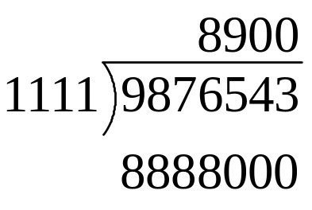
for( k = quotientSize - 1; k >= 0; k-- )
quotient[k] = 10;
do {
quotient[k]--
buffer = divisor * quotient
} while( dividend < buffer )
if( dividend == buffer )
break
 | 9 | 8 | 7 | 6 | 5 | 4 | 3 | 2 | 1 | 0
dividend | 0 | 0 | 0 | 9 | 8 | 7 | 6 | 5 | 4 | 3
dividendSize | 7
 | 9 | 8 | 7 | 6 | 5 | 4 | 3 | 2 | 1 | 0
divisor | 0 | 0 | 0 | 0 | 0 | 0 | 1 | 1 | 1 | 1
divisorSize | 4
 | 9 | 8 | 7 | 6 | 5 | 4 | 3 | 2 | 1 | 0
quotient | 0 | 0 | 0 | 0 | 0 | 0 | 8 | 9 | 0 | 0
quotientSize | 4
 | 9 | 8 | 7 | 6 | 5 | 4 | 3 | 2 | 1 | 0
buffer |  |  |  | 8 | 8 | 8 | 8 | 0 | 0 | 0
k | 2

Slide 18
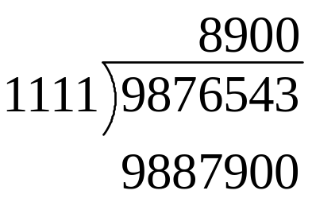
for( k = quotientSize - 1; k >= 0; k-- )
quotient[k] = 10;
do {
quotient[k]--
buffer = divisor * quotient
} while( dividend < buffer )
if( dividend == buffer )
break
 | 9 | 8 | 7 | 6 | 5 | 4 | 3 | 2 | 1 | 0
dividend | 0 | 0 | 0 | 9 | 8 | 7 | 6 | 5 | 4 | 3
dividendSize | 7
 | 9 | 8 | 7 | 6 | 5 | 4 | 3 | 2 | 1 | 0
divisor | 0 | 0 | 0 | 0 | 0 | 0 | 1 | 1 | 1 | 1
divisorSize | 4
 | 9 | 8 | 7 | 6 | 5 | 4 | 3 | 2 | 1 | 0
quotient | 0 | 0 | 0 | 0 | 0 | 0 | 8 | 9 | 0 | 0
quotientSize | 4
 | 9 | 8 | 7 | 6 | 5 | 4 | 3 | 2 | 1 | 0
buffer |  |  |  | 9 | 8 | 8 | 7 | 9 | 0 | 0
k | 2

Slide 19

for( k = quotientSize - 1; k >= 0; k-- )
quotient[k] = 10;
do {
quotient[k]--
buffer = divisor * quotient
} while( dividend < buffer )
if( dividend == buffer )
break
 | 9 | 8 | 7 | 6 | 5 | 4 | 3 | 2 | 1 | 0
dividend | 0 | 0 | 0 | 9 | 8 | 7 | 6 | 5 | 4 | 3
dividendSize | 7
 | 9 | 8 | 7 | 6 | 5 | 4 | 3 | 2 | 1 | 0
divisor | 0 | 0 | 0 | 0 | 0 | 0 | 1 | 1 | 1 | 1
divisorSize | 4
 | 9 | 8 | 7 | 6 | 5 | 4 | 3 | 2 | 1 | 0
quotient | 0 | 0 | 0 | 0 | 0 | 0 | 8 | 8 | 0 | 0
quotientSize | 4
 | 9 | 8 | 7 | 6 | 5 | 4 | 3 | 2 | 1 | 0
buffer |  |  |  | 9 | 8 | 8 | 7 | 9 | 0 | 0
k | 2

Slide 20
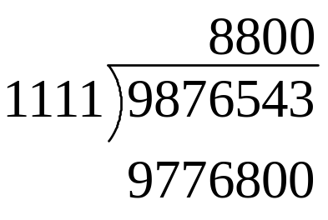
for( k = quotientSize - 1; k >= 0; k-- )
quotient[k] = 10;
do {
quotient[k]--
buffer = divisor * quotient
} while( dividend < buffer )
if( dividend == buffer )
break
 | 9 | 8 | 7 | 6 | 5 | 4 | 3 | 2 | 1 | 0
dividend | 0 | 0 | 0 | 9 | 8 | 7 | 6 | 5 | 4 | 3
dividendSize | 7
 | 9 | 8 | 7 | 6 | 5 | 4 | 3 | 2 | 1 | 0
divisor | 0 | 0 | 0 | 0 | 0 | 0 | 1 | 1 | 1 | 1
divisorSize | 4
 | 9 | 8 | 7 | 6 | 5 | 4 | 3 | 2 | 1 | 0
quotient | 0 | 0 | 0 | 0 | 0 | 0 | 8 | 8 | 0 | 0
quotientSize | 4
 | 9 | 8 | 7 | 6 | 5 | 4 | 3 | 2 | 1 | 0
buffer |  |  |  | 9 | 7 | 7 | 6 | 8 | 0 | 0
k | 2

Slide 21
for( k = quotientSize - 1; k >= 0; k-- )
quotient[k] = 10;
do {
quotient[k]--
buffer = divisor * quotient
} while( dividend < buffer )
if( dividend == buffer )
break
 | 9 | 8 | 7 | 6 | 5 | 4 | 3 | 2 | 1 | 0
dividend | 0 | 0 | 0 | 9 | 8 | 7 | 6 | 5 | 4 | 3
dividendSize | 7
 | 9 | 8 | 7 | 6 | 5 | 4 | 3 | 2 | 1 | 0
divisor | 0 | 0 | 0 | 0 | 0 | 0 | 1 | 1 | 1 | 1
divisorSize | 4
 | 9 | 8 | 7 | 6 | 5 | 4 | 3 | 2 | 1 | 0
quotient | 0 | 0 | 0 | 0 | 0 | 0 | 8 | 8 | 0 | 0
quotientSize | 4
 | 9 | 8 | 7 | 6 | 5 | 4 | 3 | 2 | 1 | 0
buffer |  |  |  | 9 | 7 | 7 | 6 | 8 | 0 | 0
k | 1

Slide 22
for( k = quotientSize - 1; k >= 0; k-- )
quotient[k] = 10;
do {
quotient[k]--
buffer = divisor * quotient
} while( dividend < buffer )
if( dividend == buffer )
break
 | 9 | 8 | 7 | 6 | 5 | 4 | 3 | 2 | 1 | 0
dividend | 0 | 0 | 0 | 9 | 8 | 7 | 6 | 5 | 4 | 3
dividendSize | 7
 | 9 | 8 | 7 | 6 | 5 | 4 | 3 | 2 | 1 | 0
divisor | 0 | 0 | 0 | 0 | 0 | 0 | 1 | 1 | 1 | 1
divisorSize | 4
 | 9 | 8 | 7 | 6 | 5 | 4 | 3 | 2 | 1 | 0
quotient | 0 | 0 | 0 | 0 | 0 | 0 | 8 | 8 | 10 | 0
quotientSize | 4
 | 9 | 8 | 7 | 6 | 5 | 4 | 3 | 2 | 1 | 0
buffer |  |  |  | 9 | 7 | 7 | 6 | 8 | 0 | 0
k | 1

Slide 23

for( k = quotientSize - 1; k >= 0; k-- )
quotient[k] = 10;
do {
quotient[k]--
buffer = divisor * quotient
} while( dividend < buffer )
if( dividend == buffer )
break
 | 9 | 8 | 7 | 6 | 5 | 4 | 3 | 2 | 1 | 0
dividend | 0 | 0 | 0 | 9 | 8 | 7 | 6 | 5 | 4 | 3
dividendSize | 7
 | 9 | 8 | 7 | 6 | 5 | 4 | 3 | 2 | 1 | 0
divisor | 0 | 0 | 0 | 0 | 0 | 0 | 1 | 1 | 1 | 1
divisorSize | 4
 | 9 | 8 | 7 | 6 | 5 | 4 | 3 | 2 | 1 | 0
quotient | 0 | 0 | 0 | 0 | 0 | 0 | 8 | 8 | 9 | 0
quotientSize | 4
 | 9 | 8 | 7 | 6 | 5 | 4 | 3 | 2 | 1 | 0
buffer |  |  |  | 9 | 7 | 7 | 6 | 8 | 0 | 0
k | 1

Slide 24
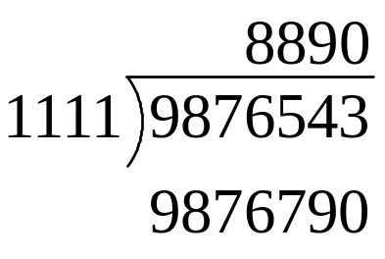
for( k = quotientSize - 1; k >= 0; k-- )
quotient[k] = 10;
do {
quotient[k]--
buffer = divisor * quotient
} while( dividend < buffer )
if( dividend == buffer )
break
 | 9 | 8 | 7 | 6 | 5 | 4 | 3 | 2 | 1 | 0
dividend | 0 | 0 | 0 | 9 | 8 | 7 | 6 | 5 | 4 | 3
dividendSize | 7
 | 9 | 8 | 7 | 6 | 5 | 4 | 3 | 2 | 1 | 0
divisor | 0 | 0 | 0 | 0 | 0 | 0 | 1 | 1 | 1 | 1
divisorSize | 4
 | 9 | 8 | 7 | 6 | 5 | 4 | 3 | 2 | 1 | 0
quotient | 0 | 0 | 0 | 0 | 0 | 0 | 8 | 8 | 9 | 0
quotientSize | 4
 | 9 | 8 | 7 | 6 | 5 | 4 | 3 | 2 | 1 | 0
buffer |  |  |  | 9 | 8 | 7 | 6 | 7 | 9 | 0
k | 1

Slide 25
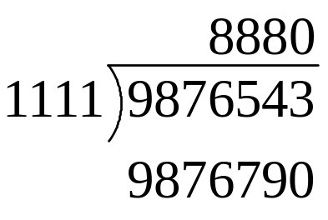
for( k = quotientSize - 1; k >= 0; k-- )
quotient[k] = 10;
do {
quotient[k]--
buffer = divisor * quotient
} while( dividend < buffer )
if( dividend == buffer )
break
 | 9 | 8 | 7 | 6 | 5 | 4 | 3 | 2 | 1 | 0
dividend | 0 | 0 | 0 | 9 | 8 | 7 | 6 | 5 | 4 | 3
dividendSize | 7
 | 9 | 8 | 7 | 6 | 5 | 4 | 3 | 2 | 1 | 0
divisor | 0 | 0 | 0 | 0 | 0 | 0 | 1 | 1 | 1 | 1
divisorSize | 4
 | 9 | 8 | 7 | 6 | 5 | 4 | 3 | 2 | 1 | 0
quotient | 0 | 0 | 0 | 0 | 0 | 0 | 8 | 8 | 8 | 0
quotientSize | 4
 | 9 | 8 | 7 | 6 | 5 | 4 | 3 | 2 | 1 | 0
buffer |  |  |  | 9 | 8 | 7 | 6 | 7 | 9 | 0
k | 1

Slide 26

for( k = quotientSize - 1; k >= 0; k-- )
quotient[k] = 10;
do {
quotient[k]--
buffer = divisor * quotient
} while( dividend < buffer )
if( dividend == buffer )
break
 | 9 | 8 | 7 | 6 | 5 | 4 | 3 | 2 | 1 | 0
dividend | 0 | 0 | 0 | 9 | 8 | 7 | 6 | 5 | 4 | 3
dividendSize | 7
 | 9 | 8 | 7 | 6 | 5 | 4 | 3 | 2 | 1 | 0
divisor | 0 | 0 | 0 | 0 | 0 | 0 | 1 | 1 | 1 | 1
divisorSize | 4
 | 9 | 8 | 7 | 6 | 5 | 4 | 3 | 2 | 1 | 0
quotient | 0 | 0 | 0 | 0 | 0 | 0 | 8 | 8 | 8 | 0
quotientSize | 4
 | 9 | 8 | 7 | 6 | 5 | 4 | 3 | 2 | 1 | 0
buffer |  |  |  | 9 | 8 | 6 | 5 | 6 | 8 | 0
k | 1

Slide 27
for( k = quotientSize - 1; k >= 0; k-- )
quotient[k] = 10;
do {
quotient[k]--
buffer = divisor * quotient
} while( dividend < buffer )
if( dividend == buffer )
break
 | 9 | 8 | 7 | 6 | 5 | 4 | 3 | 2 | 1 | 0
dividend | 0 | 0 | 0 | 9 | 8 | 7 | 6 | 5 | 4 | 3
dividendSize | 7
 | 9 | 8 | 7 | 6 | 5 | 4 | 3 | 2 | 1 | 0
divisor | 0 | 0 | 0 | 0 | 0 | 0 | 1 | 1 | 1 | 1
divisorSize | 4
 | 9 | 8 | 7 | 6 | 5 | 4 | 3 | 2 | 1 | 0
quotient | 0 | 0 | 0 | 0 | 0 | 0 | 8 | 8 | 8 | 0
quotientSize | 4
 | 9 | 8 | 7 | 6 | 5 | 4 | 3 | 2 | 1 | 0
buffer |  |  |  | 9 | 8 | 6 | 5 | 6 | 8 | 0
k | 0

Slide 28
for( k = quotientSize - 1; k >= 0; k-- )
quotient[k] = 10;
do {
quotient[k]--
buffer = divisor * quotient
} while( dividend < buffer )
if( dividend == buffer )
break
 | 9 | 8 | 7 | 6 | 5 | 4 | 3 | 2 | 1 | 0
dividend | 0 | 0 | 0 | 9 | 8 | 7 | 6 | 5 | 4 | 3
dividendSize | 7
 | 9 | 8 | 7 | 6 | 5 | 4 | 3 | 2 | 1 | 0
divisor | 0 | 0 | 0 | 0 | 0 | 0 | 1 | 1 | 1 | 1
divisorSize | 4
 | 9 | 8 | 7 | 6 | 5 | 4 | 3 | 2 | 1 | 0
quotient | 0 | 0 | 0 | 0 | 0 | 0 | 8 | 8 | 8 | 10
quotientSize | 4
 | 9 | 8 | 7 | 6 | 5 | 4 | 3 | 2 | 1 | 0
buffer |  |  |  | 9 | 8 | 6 | 5 | 6 | 8 | 0
k | 0

Slide 29

for( k = quotientSize - 1; k >= 0; k-- )
quotient[k] = 10;
do {
quotient[k]--
buffer = divisor * quotient
} while( dividend < buffer )
if( dividend == buffer )
break
 | 9 | 8 | 7 | 6 | 5 | 4 | 3 | 2 | 1 | 0
dividend | 0 | 0 | 0 | 9 | 8 | 7 | 6 | 5 | 4 | 3
dividendSize | 7
 | 9 | 8 | 7 | 6 | 5 | 4 | 3 | 2 | 1 | 0
divisor | 0 | 0 | 0 | 0 | 0 | 0 | 1 | 1 | 1 | 1
divisorSize | 4
 | 9 | 8 | 7 | 6 | 5 | 4 | 3 | 2 | 1 | 0
quotient | 0 | 0 | 0 | 0 | 0 | 0 | 8 | 8 | 8 | 9
quotientSize | 4
 | 9 | 8 | 7 | 6 | 5 | 4 | 3 | 2 | 1 | 0
buffer |  |  |  | 9 | 8 | 6 | 5 | 6 | 8 | 0
k | 0

Slide 30
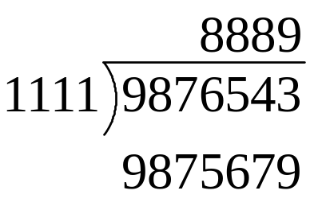
for( k = quotientSize - 1; k >= 0; k-- )
quotient[k] = 10;
do {
quotient[k]--
buffer = divisor * quotient
} while( dividend < buffer )
if( dividend == buffer )
break
 | 9 | 8 | 7 | 6 | 5 | 4 | 3 | 2 | 1 | 0
dividend | 0 | 0 | 0 | 9 | 8 | 7 | 6 | 5 | 4 | 3
dividendSize | 7
 | 9 | 8 | 7 | 6 | 5 | 4 | 3 | 2 | 1 | 0
divisor | 0 | 0 | 0 | 0 | 0 | 0 | 1 | 1 | 1 | 1
divisorSize | 4
 | 9 | 8 | 7 | 6 | 5 | 4 | 3 | 2 | 1 | 0
quotient | 0 | 0 | 0 | 0 | 0 | 0 | 8 | 8 | 8 | 9
quotientSize | 4
 | 9 | 8 | 7 | 6 | 5 | 4 | 3 | 2 | 1 | 0
buffer |  |  |  | 9 | 8 | 7 | 5 | 6 | 7 | 9
k | 0

Slide 31
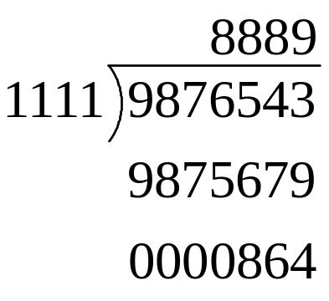
for( k = quotientSize - 1; k >= 0; k-- )
quotient[k] = 10;
do {
quotient[k]--
buffer = divisor * quotient
} while( dividend < buffer )
if( dividend == buffer )
break
 | 9 | 8 | 7 | 6 | 5 | 4 | 3 | 2 | 1 | 0
dividend | 0 | 0 | 0 | 9 | 8 | 7 | 6 | 5 | 4 | 3
dividendSize | 7
 | 9 | 8 | 7 | 6 | 5 | 4 | 3 | 2 | 1 | 0
divisor | 0 | 0 | 0 | 0 | 0 | 0 | 1 | 1 | 1 | 1
divisorSize | 4
 | 9 | 8 | 7 | 6 | 5 | 4 | 3 | 2 | 1 | 0
quotient | 0 | 0 | 0 | 0 | 0 | 0 | 8 | 8 | 8 | 9
quotientSize | 4
 | 9 | 8 | 7 | 6 | 5 | 4 | 3 | 2 | 1 | 0
buffer |  |  |  | 9 | 8 | 7 | 5 | 6 | 7 | 9
k | 0

Slide 33
n = dividendSize – divisorSize
buffer = divisor shift left by n positions
if( dividend < buffer )
quotientSize = dividendSize – divisorSize
else
quotientSize = dividendSize – divisorSize + 1
quotient = 0
 | 9 | 8 | 7 | 6 | 5 | 4 | 3 | 2 | 1 | 0
dividend | 0 | 0 | 0 | 1 | 7 | 5 | 7 | 0 | 0 | 0
dividendSize | 7
 | 9 | 8 | 7 | 6 | 5 | 4 | 3 | 2 | 1 | 0
divisor | 0 | 0 | 0 | 0 | 0 | 0 | 2 | 0 | 0 | 0
divisorSize | 4
 | 9 | 8 | 7 | 6 | 5 | 4 | 3 | 2 | 1 | 0
quotient
quotientSize
 | 9 | 8 | 7 | 6 | 5 | 4 | 3 | 2 | 1 | 0
buffer
k

Slide 34
n = dividendSize – divisorSize
buffer = divisor shift left by n positions
if( dividend < buffer )
quotientSize = dividendSize – divisorSize
else
quotientSize = dividendSize – divisorSize + 1
quotient = 0
 | 9 | 8 | 7 | 6 | 5 | 4 | 3 | 2 | 1 | 0
dividend | 0 | 0 | 0 | 1 | 7 | 5 | 7 | 0 | 0 | 0
dividendSize | 7
 | 9 | 8 | 7 | 6 | 5 | 4 | 3 | 2 | 1 | 0
divisor | 0 | 0 | 0 | 0 | 0 | 0 | 2 | 0 | 0 | 0
divisorSize | 4
 | 9 | 8 | 7 | 6 | 5 | 4 | 3 | 2 | 1 | 0
quotient
quotientSize
 | 9 | 8 | 7 | 6 | 5 | 4 | 3 | 2 | 1 | 0
buffer |  |  |  | 2 | 0 | 0 | 0 | 0 | 0 | 0
k

Slide 35
n = dividendSize – divisorSize
buffer = divisor shift left by n positions
if( dividend < buffer )
quotientSize = dividendSize – divisorSize
else
quotientSize = dividendSize – divisorSize + 1
quotient = 0
 | 9 | 8 | 7 | 6 | 5 | 4 | 3 | 2 | 1 | 0
dividend | 0 | 0 | 0 | 1 | 7 | 5 | 7 | 0 | 0 | 0
dividendSize | 7
 | 9 | 8 | 7 | 6 | 5 | 4 | 3 | 2 | 1 | 0
divisor | 0 | 0 | 0 | 0 | 0 | 0 | 2 | 0 | 0 | 0
divisorSize | 4
 | 9 | 8 | 7 | 6 | 5 | 4 | 3 | 2 | 1 | 0
quotient
quotientSize | 3
 | 9 | 8 | 7 | 6 | 5 | 4 | 3 | 2 | 1 | 0
buffer |  |  |  | 2 | 0 | 0 | 0 | 0 | 0 | 0
k

Slide 36
n = dividendSize – divisorSize
buffer = divisor shift left by n positions
if( dividend < buffer )
quotientSize = dividendSize – divisorSize
else
quotientSize = dividendSize – divisorSize + 1
quotient = 0
 | 9 | 8 | 7 | 6 | 5 | 4 | 3 | 2 | 1 | 0
dividend | 0 | 0 | 0 | 1 | 7 | 5 | 7 | 0 | 0 | 0
dividendSize | 7
 | 9 | 8 | 7 | 6 | 5 | 4 | 3 | 2 | 1 | 0
divisor | 0 | 0 | 0 | 0 | 0 | 0 | 2 | 0 | 0 | 0
divisorSize | 4
 | 9 | 8 | 7 | 6 | 5 | 4 | 3 | 2 | 1 | 0
quotient | 0 | 0 | 0 | 0 | 0 | 0 | 0 | 0 | 0 | 0
quotientSize | 3
 | 9 | 8 | 7 | 6 | 5 | 4 | 3 | 2 | 1 | 0
buffer |  |  |  | 2 | 0 | 0 | 0 | 0 | 0 | 0
k

Slide 37
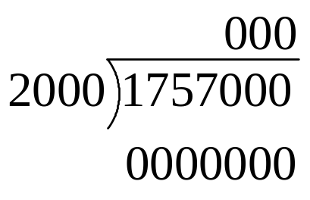
for( k = quotientSize - 1; k >= 0; k-- )
quotient[k] = 10;
do {
quotient[k]--
buffer = divisor * quotient
} while( dividend < buffer )
if( dividend == buffer )
break
 | 9 | 8 | 7 | 6 | 5 | 4 | 3 | 2 | 1 | 0
dividend | 0 | 0 | 0 | 1 | 7 | 5 | 7 | 0 | 0 | 0
dividendSize | 7
 | 9 | 8 | 7 | 6 | 5 | 4 | 3 | 2 | 1 | 0
divisor | 0 | 0 | 0 | 0 | 0 | 0 | 2 | 0 | 0 | 0
divisorSize | 4
 | 9 | 8 | 7 | 6 | 5 | 4 | 3 | 2 | 1 | 0
quotient | 0 | 0 | 0 | 0 | 0 | 0 | 0 | 0 | 0 | 0
quotientSize | 3
 | 9 | 8 | 7 | 6 | 5 | 4 | 3 | 2 | 1 | 0
buffer
k | 2

Slide 38
for( k = quotientSize - 1; k >= 0; k-- )
quotient[k] = 10;
do {
quotient[k]--
buffer = divisor * quotient
} while( dividend < buffer )
if( dividend == buffer )
break
 | 9 | 8 | 7 | 6 | 5 | 4 | 3 | 2 | 1 | 0
dividend | 0 | 0 | 0 | 1 | 7 | 5 | 7 | 0 | 0 | 0
dividendSize | 7
 | 9 | 8 | 7 | 6 | 5 | 4 | 3 | 2 | 1 | 0
divisor | 0 | 0 | 0 | 0 | 0 | 0 | 2 | 0 | 0 | 0
divisorSize | 4
 | 9 | 8 | 7 | 6 | 5 | 4 | 3 | 2 | 1 | 0
quotient | 0 | 0 | 0 | 0 | 0 | 0 | 0 | 10 | 0 | 0
quotientSize | 3
 | 9 | 8 | 7 | 6 | 5 | 4 | 3 | 2 | 1 | 0
buffer
k | 2

Slide 39

for( k = quotientSize - 1; k >= 0; k-- )
quotient[k] = 10;
do {
quotient[k]--
buffer = divisor * quotient
} while( dividend < buffer )
if( dividend == buffer )
break
 | 9 | 8 | 7 | 6 | 5 | 4 | 3 | 2 | 1 | 0
dividend | 0 | 0 | 0 | 1 | 7 | 5 | 7 | 0 | 0 | 0
dividendSize | 7
 | 9 | 8 | 7 | 6 | 5 | 4 | 3 | 2 | 1 | 0
divisor | 0 | 0 | 0 | 0 | 0 | 0 | 2 | 0 | 0 | 0
divisorSize | 4
 | 9 | 8 | 7 | 6 | 5 | 4 | 3 | 2 | 1 | 0
quotient | 0 | 0 | 0 | 0 | 0 | 0 | 0 | 9 | 0 | 0
quotientSize | 3
 | 9 | 8 | 7 | 6 | 5 | 4 | 3 | 2 | 1 | 0
buffer
k | 2

Slide 40
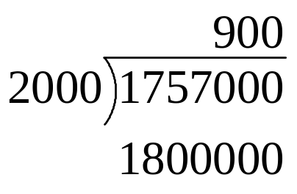
for( k = quotientSize - 1; k >= 0; k-- )
quotient[k] = 10;
do {
quotient[k]--
buffer = divisor * quotient
} while( dividend < buffer )
if( dividend == buffer )
break
 | 9 | 8 | 7 | 6 | 5 | 4 | 3 | 2 | 1 | 0
dividend | 0 | 0 | 0 | 1 | 7 | 5 | 7 | 0 | 0 | 0
dividendSize | 7
 | 9 | 8 | 7 | 6 | 5 | 4 | 3 | 2 | 1 | 0
divisor | 0 | 0 | 0 | 0 | 0 | 0 | 2 | 0 | 0 | 0
divisorSize | 4
 | 9 | 8 | 7 | 6 | 5 | 4 | 3 | 2 | 1 | 0
quotient | 0 | 0 | 0 | 0 | 0 | 0 | 0 | 9 | 0 | 0
quotientSize | 3
 | 9 | 8 | 7 | 6 | 5 | 4 | 3 | 2 | 1 | 0
buffer | 0 | 0 | 0 | 1 | 8 | 0 | 0 | 0 | 0 | 0
k | 2

Slide 41
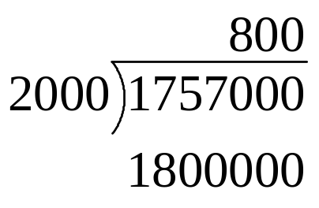
for( k = quotientSize - 1; k >= 0; k-- )
quotient[k] = 10;
do {
quotient[k]--
buffer = divisor * quotient
} while( dividend < buffer )
if( dividend == buffer )
break
 | 9 | 8 | 7 | 6 | 5 | 4 | 3 | 2 | 1 | 0
dividend | 0 | 0 | 0 | 1 | 7 | 5 | 7 | 0 | 0 | 0
dividendSize | 7
 | 9 | 8 | 7 | 6 | 5 | 4 | 3 | 2 | 1 | 0
divisor | 0 | 0 | 0 | 0 | 0 | 0 | 2 | 0 | 0 | 0
divisorSize | 4
 | 9 | 8 | 7 | 6 | 5 | 4 | 3 | 2 | 1 | 0
quotient | 0 | 0 | 0 | 0 | 0 | 0 | 0 | 8 | 0 | 0
quotientSize | 3
 | 9 | 8 | 7 | 6 | 5 | 4 | 3 | 2 | 1 | 0
buffer | 0 | 0 | 0 | 1 | 8 | 0 | 0 | 0 | 0 | 0
k | 2

Slide 42
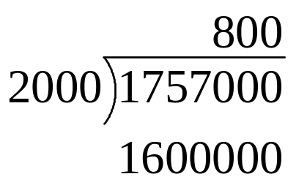
for( k = quotientSize - 1; k >= 0; k-- )
quotient[k] = 10;
do {
quotient[k]--
buffer = divisor * quotient
} while( dividend < buffer )
if( dividend == buffer )
break
 | 9 | 8 | 7 | 6 | 5 | 4 | 3 | 2 | 1 | 0
dividend | 0 | 0 | 0 | 1 | 7 | 5 | 7 | 0 | 0 | 0
dividendSize | 7
 | 9 | 8 | 7 | 6 | 5 | 4 | 3 | 2 | 1 | 0
divisor | 0 | 0 | 0 | 0 | 0 | 0 | 2 | 0 | 0 | 0
divisorSize | 4
 | 9 | 8 | 7 | 6 | 5 | 4 | 3 | 2 | 1 | 0
quotient | 0 | 0 | 0 | 0 | 0 | 0 | 0 | 8 | 0 | 0
quotientSize | 3
 | 9 | 8 | 7 | 6 | 5 | 4 | 3 | 2 | 1 | 0
buffer | 0 | 0 | 0 | 1 | 6 | 0 | 0 | 0 | 0 | 0
k | 2

Slide 43
for( k = quotientSize - 1; k >= 0; k-- )
quotient[k] = 10;
do {
quotient[k]--
buffer = divisor * quotient
} while( dividend < buffer )
if( dividend == buffer )
break
 | 9 | 8 | 7 | 6 | 5 | 4 | 3 | 2 | 1 | 0
dividend | 0 | 0 | 0 | 1 | 7 | 5 | 7 | 0 | 0 | 0
dividendSize | 7
 | 9 | 8 | 7 | 6 | 5 | 4 | 3 | 2 | 1 | 0
divisor | 0 | 0 | 0 | 0 | 0 | 0 | 2 | 0 | 0 | 0
divisorSize | 4
 | 9 | 8 | 7 | 6 | 5 | 4 | 3 | 2 | 1 | 0
quotient | 0 | 0 | 0 | 0 | 0 | 0 | 0 | 8 | 0 | 0
quotientSize | 3
 | 9 | 8 | 7 | 6 | 5 | 4 | 3 | 2 | 1 | 0
buffer | 0 | 0 | 0 | 1 | 6 | 0 | 0 | 0 | 0 | 0
k | 1

Slide 44
for( k = quotientSize - 1; k >= 0; k-- )
quotient[k] = 10;
do {
quotient[k]--
buffer = divisor * quotient
} while( dividend < buffer )
if( dividend == buffer )
break
 | 9 | 8 | 7 | 6 | 5 | 4 | 3 | 2 | 1 | 0
dividend | 0 | 0 | 0 | 1 | 7 | 5 | 7 | 0 | 0 | 0
dividendSize | 7
 | 9 | 8 | 7 | 6 | 5 | 4 | 3 | 2 | 1 | 0
divisor | 0 | 0 | 0 | 0 | 0 | 0 | 2 | 0 | 0 | 0
divisorSize | 4
 | 9 | 8 | 7 | 6 | 5 | 4 | 3 | 2 | 1 | 0
quotient | 0 | 0 | 0 | 0 | 0 | 0 | 0 | 8 | 10 | 0
quotientSize | 3
 | 9 | 8 | 7 | 6 | 5 | 4 | 3 | 2 | 1 | 0
buffer | 0 | 0 | 0 | 1 | 6 | 0 | 0 | 0 | 0 | 0
k | 1

Slide 45
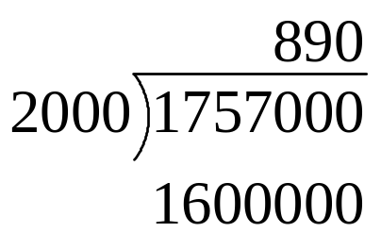
for( k = quotientSize - 1; k >= 0; k-- )
quotient[k] = 10;
do {
quotient[k]--
buffer = divisor * quotient
} while( dividend < buffer )
if( dividend == buffer )
break
 | 9 | 8 | 7 | 6 | 5 | 4 | 3 | 2 | 1 | 0
dividend | 0 | 0 | 0 | 1 | 7 | 5 | 7 | 0 | 0 | 0
dividendSize | 7
 | 9 | 8 | 7 | 6 | 5 | 4 | 3 | 2 | 1 | 0
divisor | 0 | 0 | 0 | 0 | 0 | 0 | 2 | 0 | 0 | 0
divisorSize | 4
 | 9 | 8 | 7 | 6 | 5 | 4 | 3 | 2 | 1 | 0
quotient | 0 | 0 | 0 | 0 | 0 | 0 | 0 | 8 | 9 | 0
quotientSize | 3
 | 9 | 8 | 7 | 6 | 5 | 4 | 3 | 2 | 1 | 0
buffer | 0 | 0 | 0 | 1 | 6 | 0 | 0 | 0 | 0 | 0
k | 1

Slide 46
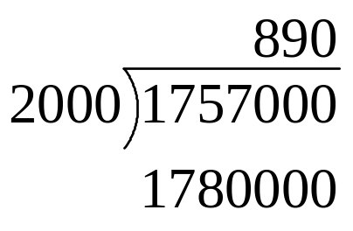
for( k = quotientSize - 1; k >= 0; k-- )
quotient[k] = 10;
do {
quotient[k]--
buffer = divisor * quotient
} while( dividend < buffer )
if( dividend == buffer )
break
 | 9 | 8 | 7 | 6 | 5 | 4 | 3 | 2 | 1 | 0
dividend | 0 | 0 | 0 | 1 | 7 | 5 | 7 | 0 | 0 | 0
dividendSize | 7
 | 9 | 8 | 7 | 6 | 5 | 4 | 3 | 2 | 1 | 0
divisor | 0 | 0 | 0 | 0 | 0 | 0 | 2 | 0 | 0 | 0
divisorSize | 4
 | 9 | 8 | 7 | 6 | 5 | 4 | 3 | 2 | 1 | 0
quotient | 0 | 0 | 0 | 0 | 0 | 0 | 0 | 8 | 9 | 0
quotientSize | 3
 | 9 | 8 | 7 | 6 | 5 | 4 | 3 | 2 | 1 | 0
buffer | 0 | 0 | 0 | 1 | 7 | 8 | 0 | 0 | 0 | 0
k | 1

Slide 47
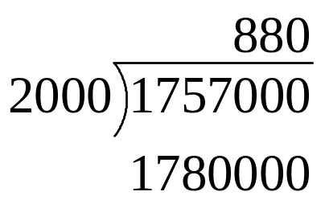
for( k = quotientSize - 1; k >= 0; k-- )
quotient[k] = 10;
do {
quotient[k]--
buffer = divisor * quotient
} while( dividend < buffer )
if( dividend == buffer )
break
 | 9 | 8 | 7 | 6 | 5 | 4 | 3 | 2 | 1 | 0
dividend | 0 | 0 | 0 | 1 | 7 | 5 | 7 | 0 | 0 | 0
dividendSize | 7
 | 9 | 8 | 7 | 6 | 5 | 4 | 3 | 2 | 1 | 0
divisor | 0 | 0 | 0 | 0 | 0 | 0 | 2 | 0 | 0 | 0
divisorSize | 4
 | 9 | 8 | 7 | 6 | 5 | 4 | 3 | 2 | 1 | 0
quotient | 0 | 0 | 0 | 0 | 0 | 0 | 0 | 8 | 8 | 0
quotientSize | 3
 | 9 | 8 | 7 | 6 | 5 | 4 | 3 | 2 | 1 | 0
buffer | 0 | 0 | 0 | 1 | 7 | 8 | 0 | 0 | 0 | 0
k | 1

Slide 48

for( k = quotientSize - 1; k >= 0; k-- )
quotient[k] = 10;
do {
quotient[k]--
buffer = divisor * quotient
} while( dividend < buffer )
if( dividend == buffer )
break
 | 9 | 8 | 7 | 6 | 5 | 4 | 3 | 2 | 1 | 0
dividend | 0 | 0 | 0 | 1 | 7 | 5 | 7 | 0 | 0 | 0
dividendSize | 7
 | 9 | 8 | 7 | 6 | 5 | 4 | 3 | 2 | 1 | 0
divisor | 0 | 0 | 0 | 0 | 0 | 0 | 2 | 0 | 0 | 0
divisorSize | 4
 | 9 | 8 | 7 | 6 | 5 | 4 | 3 | 2 | 1 | 0
quotient | 0 | 0 | 0 | 0 | 0 | 0 | 0 | 8 | 8 | 0
quotientSize | 3
 | 9 | 8 | 7 | 6 | 5 | 4 | 3 | 2 | 1 | 0
buffer | 0 | 0 | 0 | 1 | 7 | 6 | 0 | 0 | 0 | 0
k | 1

Slide 49
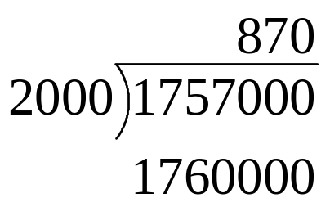
for( k = quotientSize - 1; k >= 0; k-- )
quotient[k] = 10;
do {
quotient[k]--
buffer = divisor * quotient
} while( dividend < buffer )
if( dividend == buffer )
break
 | 9 | 8 | 7 | 6 | 5 | 4 | 3 | 2 | 1 | 0
dividend | 0 | 0 | 0 | 1 | 7 | 5 | 7 | 0 | 0 | 0
dividendSize | 7
 | 9 | 8 | 7 | 6 | 5 | 4 | 3 | 2 | 1 | 0
divisor | 0 | 0 | 0 | 0 | 0 | 0 | 2 | 0 | 0 | 0
divisorSize | 4
 | 9 | 8 | 7 | 6 | 5 | 4 | 3 | 2 | 1 | 0
quotient | 0 | 0 | 0 | 0 | 0 | 0 | 0 | 8 | 7 | 0
quotientSize | 3
 | 9 | 8 | 7 | 6 | 5 | 4 | 3 | 2 | 1 | 0
buffer | 0 | 0 | 0 | 1 | 7 | 6 | 0 | 0 | 0 | 0
k | 1

Slide 50

for( k = quotientSize - 1; k >= 0; k-- )
quotient[k] = 10;
do {
quotient[k]--
buffer = divisor * quotient
} while( dividend < buffer )
if( dividend == buffer )
break
 | 9 | 8 | 7 | 6 | 5 | 4 | 3 | 2 | 1 | 0
dividend | 0 | 0 | 0 | 1 | 7 | 5 | 7 | 0 | 0 | 0
dividendSize | 7
 | 9 | 8 | 7 | 6 | 5 | 4 | 3 | 2 | 1 | 0
divisor | 0 | 0 | 0 | 0 | 0 | 0 | 2 | 0 | 0 | 0
divisorSize | 4
 | 9 | 8 | 7 | 6 | 5 | 4 | 3 | 2 | 1 | 0
quotient | 0 | 0 | 0 | 0 | 0 | 0 | 0 | 8 | 7 | 0
quotientSize | 3
 | 9 | 8 | 7 | 6 | 5 | 4 | 3 | 2 | 1 | 0
buffer | 0 | 0 | 0 | 1 | 7 | 4 | 0 | 0 | 0 | 0
k | 1

Slide 51
for( k = quotientSize - 1; k >= 0; k-- )
quotient[k] = 10;
do {
quotient[k]--
buffer = divisor * quotient
} while( dividend < buffer )
if( dividend == buffer )
break
 | 9 | 8 | 7 | 6 | 5 | 4 | 3 | 2 | 1 | 0
dividend | 0 | 0 | 0 | 1 | 7 | 5 | 7 | 0 | 0 | 0
dividendSize | 7
 | 9 | 8 | 7 | 6 | 5 | 4 | 3 | 2 | 1 | 0
divisor | 0 | 0 | 0 | 0 | 0 | 0 | 2 | 0 | 0 | 0
divisorSize | 4
 | 9 | 8 | 7 | 6 | 5 | 4 | 3 | 2 | 1 | 0
quotient | 0 | 0 | 0 | 0 | 0 | 0 | 0 | 8 | 7 | 0
quotientSize | 3
 | 9 | 8 | 7 | 6 | 5 | 4 | 3 | 2 | 1 | 0
buffer | 0 | 0 | 0 | 1 | 7 | 4 | 0 | 0 | 0 | 0
k | 0

Slide 52
for( k = quotientSize - 1; k >= 0; k-- )
quotient[k] = 10;
do {
quotient[k]--
buffer = divisor * quotient
} while( dividend < buffer )
if( dividend == buffer )
break
 | 9 | 8 | 7 | 6 | 5 | 4 | 3 | 2 | 1 | 0
dividend | 0 | 0 | 0 | 1 | 7 | 5 | 7 | 0 | 0 | 0
dividendSize | 7
 | 9 | 8 | 7 | 6 | 5 | 4 | 3 | 2 | 1 | 0
divisor | 0 | 0 | 0 | 0 | 0 | 0 | 2 | 0 | 0 | 0
divisorSize | 4
 | 9 | 8 | 7 | 6 | 5 | 4 | 3 | 2 | 1 | 0
quotient | 0 | 0 | 0 | 0 | 0 | 0 | 0 | 8 | 7 | 10
quotientSize | 3
 | 9 | 8 | 7 | 6 | 5 | 4 | 3 | 2 | 1 | 0
buffer | 0 | 0 | 0 | 1 | 7 | 4 | 0 | 0 | 0 | 0
k | 0

Slide 53
for( k = quotientSize - 1; k >= 0; k-- )
quotient[k] = 10;
do {
quotient[k]--
buffer = divisor * quotient
} while( dividend < buffer )
if( dividend == buffer )
break
 | 9 | 8 | 7 | 6 | 5 | 4 | 3 | 2 | 1 | 0
dividend | 0 | 0 | 0 | 1 | 7 | 5 | 7 | 0 | 0 | 0
dividendSize | 7
 | 9 | 8 | 7 | 6 | 5 | 4 | 3 | 2 | 1 | 0
divisor | 0 | 0 | 0 | 0 | 0 | 0 | 2 | 0 | 0 | 0
divisorSize | 4
 | 9 | 8 | 7 | 6 | 5 | 4 | 3 | 2 | 1 | 0
quotient | 0 | 0 | 0 | 0 | 0 | 0 | 0 | 8 | 7 | 9
quotientSize | 3
 | 9 | 8 | 7 | 6 | 5 | 4 | 3 | 2 | 1 | 0
buffer | 0 | 0 | 0 | 1 | 7 | 4 | 0 | 0 | 0 | 0
k | 0

Slide 54
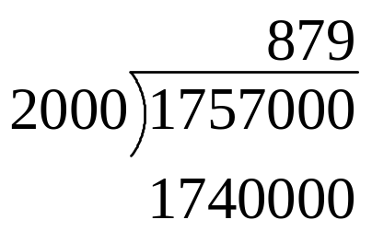
for( k = quotientSize - 1; k >= 0; k-- )
quotient[k] = 10;
do {
quotient[k]--
buffer = divisor * quotient
} while( dividend < buffer )
if( dividend == buffer )
break
 | 9 | 8 | 7 | 6 | 5 | 4 | 3 | 2 | 1 | 0
dividend | 0 | 0 | 0 | 1 | 7 | 5 | 7 | 0 | 0 | 0
dividendSize | 7
 | 9 | 8 | 7 | 6 | 5 | 4 | 3 | 2 | 1 | 0
divisor | 0 | 0 | 0 | 0 | 0 | 0 | 2 | 0 | 0 | 0
divisorSize | 4
 | 9 | 8 | 7 | 6 | 5 | 4 | 3 | 2 | 1 | 0
quotient | 0 | 0 | 0 | 0 | 0 | 0 | 0 | 8 | 7 | 9
quotientSize | 3
 | 9 | 8 | 7 | 6 | 5 | 4 | 3 | 2 | 1 | 0
buffer | 0 | 0 | 0 | 1 | 7 | 4 | 0 | 0 | 0 | 0
k | 0

Slide 55
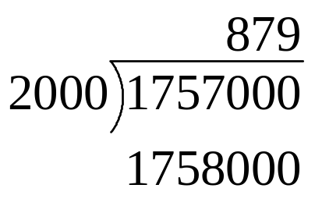
for( k = quotientSize - 1; k >= 0; k-- )
quotient[k] = 10;
do {
quotient[k]--
buffer = divisor * quotient
} while( dividend < buffer )
if( dividend == buffer )
break
 | 9 | 8 | 7 | 6 | 5 | 4 | 3 | 2 | 1 | 0
dividend | 0 | 0 | 0 | 1 | 7 | 5 | 7 | 0 | 0 | 0
dividendSize | 7
 | 9 | 8 | 7 | 6 | 5 | 4 | 3 | 2 | 1 | 0
divisor | 0 | 0 | 0 | 0 | 0 | 0 | 2 | 0 | 0 | 0
divisorSize | 4
 | 9 | 8 | 7 | 6 | 5 | 4 | 3 | 2 | 1 | 0
quotient | 0 | 0 | 0 | 0 | 0 | 0 | 0 | 8 | 7 | 9
quotientSize | 3
 | 9 | 8 | 7 | 6 | 5 | 4 | 3 | 2 | 1 | 0
buffer | 0 | 0 | 0 | 1 | 7 | 5 | 8 | 0 | 0 | 0
k | 0

Slide 56

for( k = quotientSize - 1; k >= 0; k-- )
quotient[k] = 10;
do {
quotient[k]--
buffer = divisor * quotient
} while( dividend < buffer )
if( dividend == buffer )
break
 | 9 | 8 | 7 | 6 | 5 | 4 | 3 | 2 | 1 | 0
dividend | 0 | 0 | 0 | 1 | 7 | 5 | 7 | 0 | 0 | 0
dividendSize | 7
 | 9 | 8 | 7 | 6 | 5 | 4 | 3 | 2 | 1 | 0
divisor | 0 | 0 | 0 | 0 | 0 | 0 | 2 | 0 | 0 | 0
divisorSize | 4
 | 9 | 8 | 7 | 6 | 5 | 4 | 3 | 2 | 1 | 0
quotient | 0 | 0 | 0 | 0 | 0 | 0 | 0 | 8 | 7 | 8
quotientSize | 3
 | 9 | 8 | 7 | 6 | 5 | 4 | 3 | 2 | 1 | 0
buffer | 0 | 0 | 0 | 1 | 7 | 5 | 8 | 0 | 0 | 0
k | 0

Slide 57

for( k = quotientSize - 1; k >= 0; k-- )
quotient[k] = 10;
do {
quotient[k]--
buffer = divisor * quotient
} while( dividend < buffer )
if( dividend == buffer )
break
 | 9 | 8 | 7 | 6 | 5 | 4 | 3 | 2 | 1 | 0
dividend | 0 | 0 | 0 | 1 | 7 | 5 | 7 | 0 | 0 | 0
dividendSize | 7
 | 9 | 8 | 7 | 6 | 5 | 4 | 3 | 2 | 1 | 0
divisor | 0 | 0 | 0 | 0 | 0 | 0 | 2 | 0 | 0 | 0
divisorSize | 4
 | 9 | 8 | 7 | 6 | 5 | 4 | 3 | 2 | 1 | 0
quotient | 0 | 0 | 0 | 0 | 0 | 0 | 0 | 8 | 7 | 8
quotientSize | 3
 | 9 | 8 | 7 | 6 | 5 | 4 | 3 | 2 | 1 | 0
buffer | 0 | 0 | 0 | 1 | 7 | 5 | 6 | 0 | 0 | 0
k | 0

Slide 58
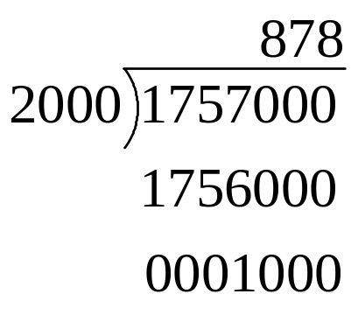
for( k = quotientSize - 1; k >= 0; k-- )
quotient[k] = 10;
do {
quotient[k]--
buffer = divisor * quotient
} while( dividend < buffer )
if( dividend == buffer )
break
 | 9 | 8 | 7 | 6 | 5 | 4 | 3 | 2 | 1 | 0
dividend | 0 | 0 | 0 | 1 | 7 | 5 | 7 | 0 | 0 | 0
dividendSize | 7
 | 9 | 8 | 7 | 6 | 5 | 4 | 3 | 2 | 1 | 0
divisor | 0 | 0 | 0 | 0 | 0 | 0 | 2 | 0 | 0 | 0
divisorSize | 4
 | 9 | 8 | 7 | 6 | 5 | 4 | 3 | 2 | 1 | 0
quotient | 0 | 0 | 0 | 0 | 0 | 0 | 0 | 8 | 7 | 8
quotientSize | 3
 | 9 | 8 | 7 | 6 | 5 | 4 | 3 | 2 | 1 | 0
buffer | 0 | 0 | 0 | 1 | 7 | 5 | 6 | 0 | 0 | 0
k | 0

